Slide 1
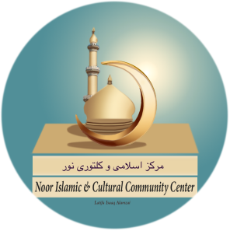
Noor Islamic & Cultural
Community Center
(NICCC)
4035 Treat Boulevard
Concord, CA 94518
Phone:
(925)768-4885
ﻤﺮﻜﺰ ﺍﺴﻼﻤﻰ ﻮ ﻜﻠﺘﻮﺮﻯ ﻨﻮﺮ
NICCC
Islamic Mortuary
August 9, 2021
Dr. Popal

Slide 2
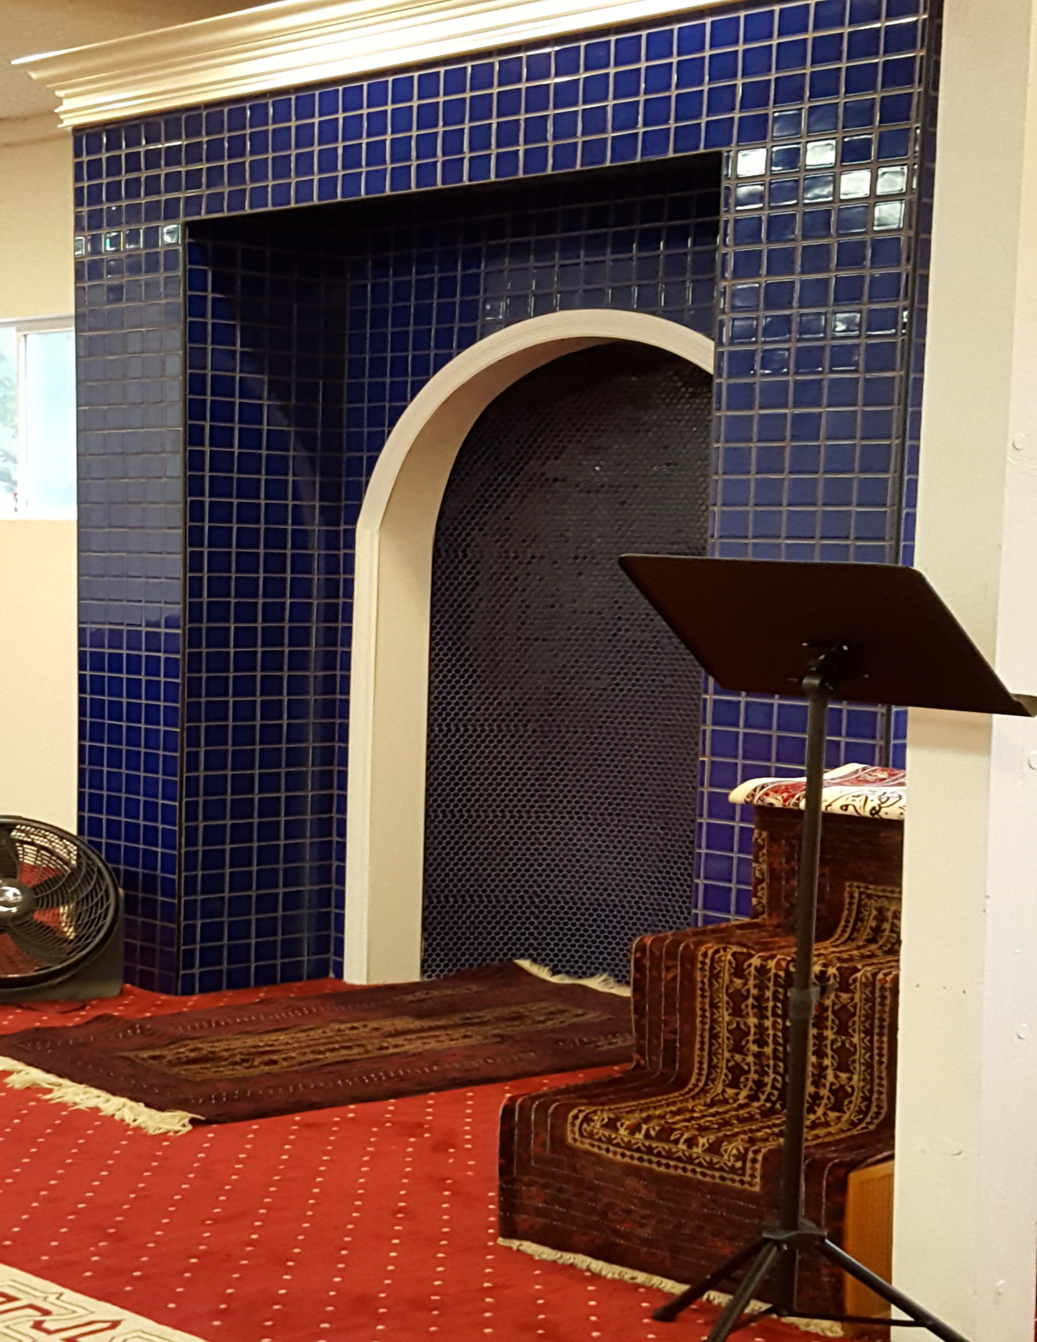
Islamic Mortuary
Noor Islamic & Cultural Community Center is proud to offer mortuary services to all Muslims of the Bay Area as follows:

Slide 3
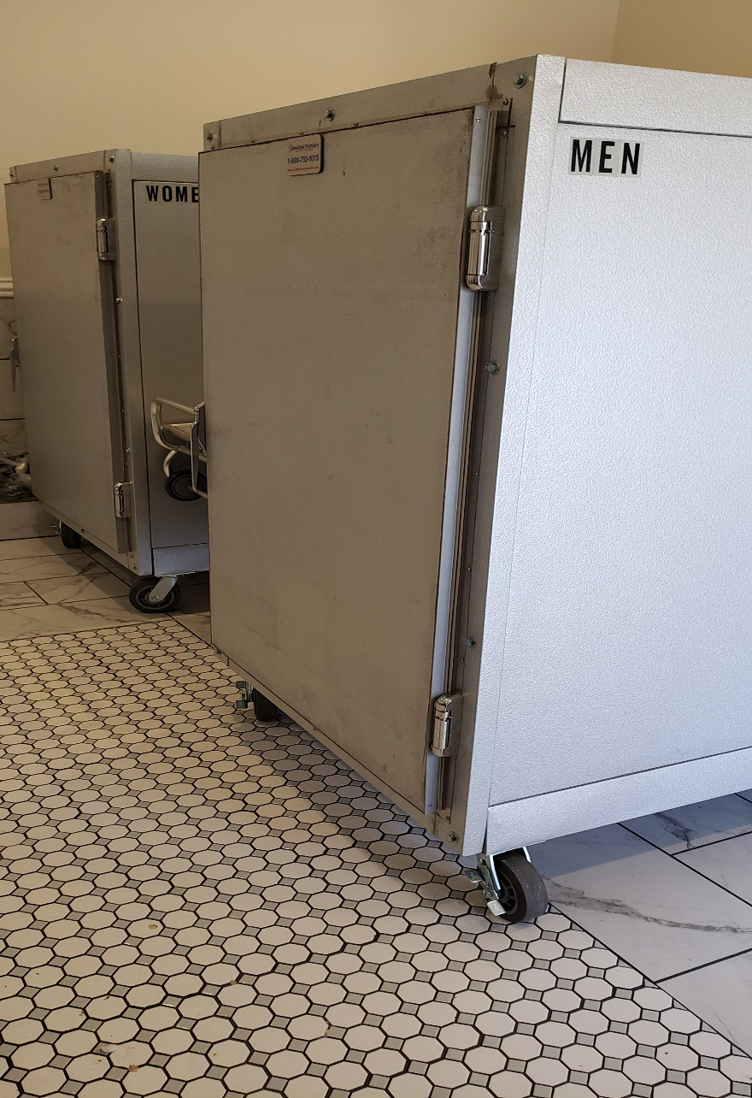
Islamic Mortuary
The Mortuary Room will be used as a holding place for deceased Muslims (Male & Female) prior to their burial ceremony.
The bodies of the deceased Muslims will be kept in body coolers. There are separate coolers for male and female bodies.

Slide 4
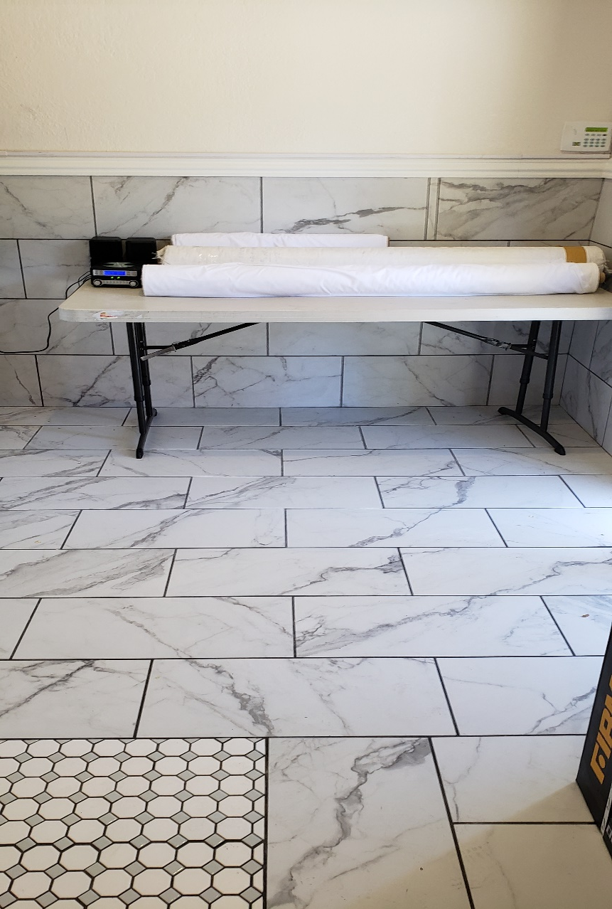
Islamic Mortuary
3. After a ceremonial
washing, the
deceased body will
be carried to a
cemetery.
4. NICCC also offers
a shroud/Kafan
package for the
convenience of
our Muslim
brothers and
sisters.

Slide 5
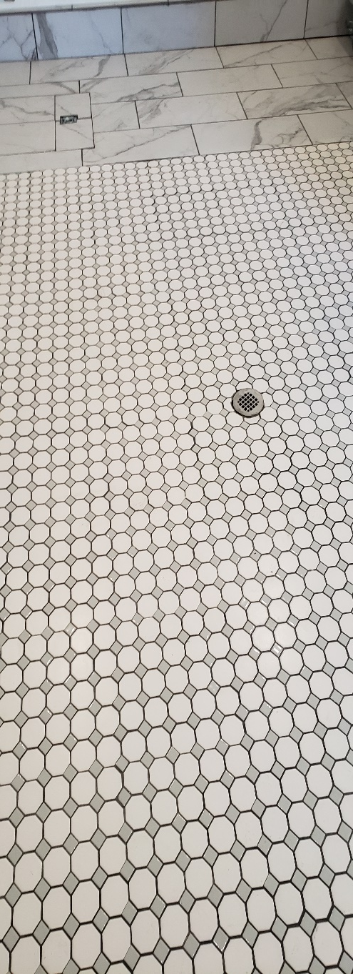
Islamic Mortuary
5. Mr. Moore, the director
of the Monument Chapel
(MC), will take care of
all the paper work and
Death Certificate.
6. A Licensed MC staff will
pick up deceased bodies
from the hospitals,
convalescent homes,
senior facilities, and
homes and bring them
to Noor Islamic &
Cultural Community
Center
7. Mr. Moore will coordinate
the burial date & time of
the burial with the
cemetery & NICCC.

Slide 6
For Information, Please
Contact
Dr. Sedique Popal
(925)768-4885
dr.popal92@gmail.com

